Slide 1
Muhammad Sohail Afzal

Slide 2
Neural Network
“The neural network is this kind of technology that is not an algorithm, it is a network that has weights on it, and you can adjust the weights so that it learns. You teach it through trials.” — Howard Rheingold

Slide 3
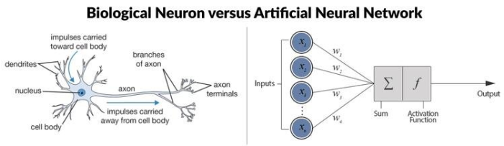
Neural Network

Slide 4
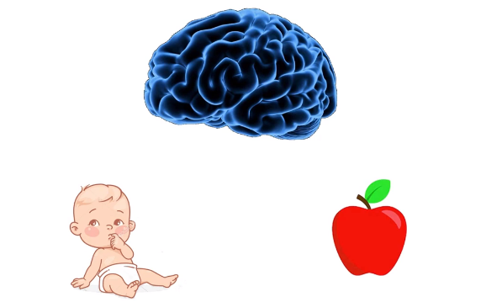
Neural Network

Slide 5
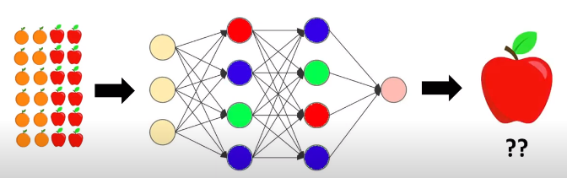
Neural Network
So we show it data, it calculates output(prediction) through forward propagation using random weights. Then it finds error by identifying how much is the difference between its prediction and actual output. Then it starts backward propagation (using gradient descent) to learn values of weights that will give minimum error and then again it generates output(prediction) through forward propagation using those updated weights. This goes on till we get minimum error.

Slide 6
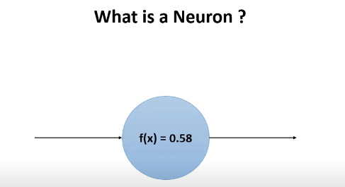
Neural Network
A function that gives some output value

Slide 7
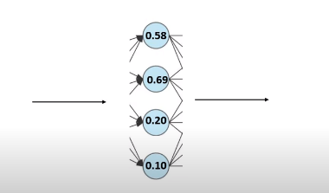
Neural Network
Different neurons exhibit different values that are responsible for learning different patterns in data

Slide 8
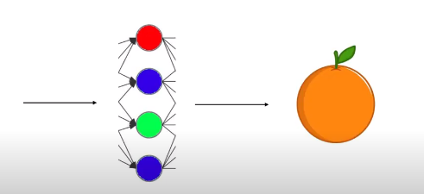
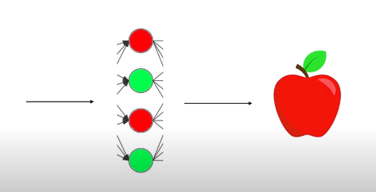
Neural Network
For example, there may be some neurons (with different values) for recognizing the color of orange and some neurons for recognizing color of apple.

Slide 9
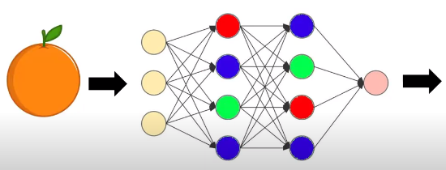
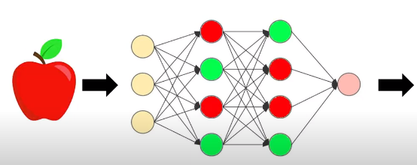
Neural Network
So when we feed apple, some neurons
get activated and when we feed apple,
some other get activated

Slide 10
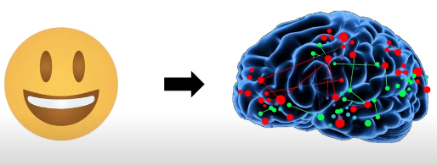
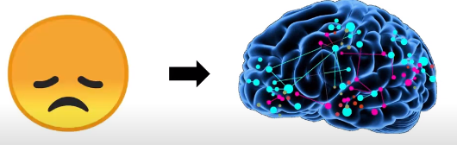
Neural Network
This is similar to human brain.
When we see something that we like, some neurons get activated and when we see something that we don’t like, some other get activated.

Slide 11
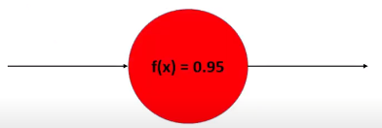
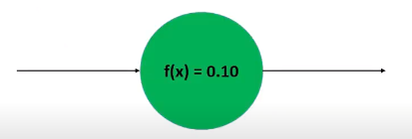
Neural Network
So due to these activation of neurons, we also call them activation functions.

Slide 12
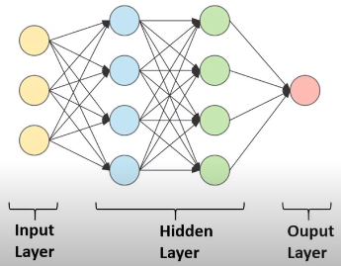
Neural Network
Collection of these neurons form layers and whole network is called neural network that has three different types of layers.

Slide 13
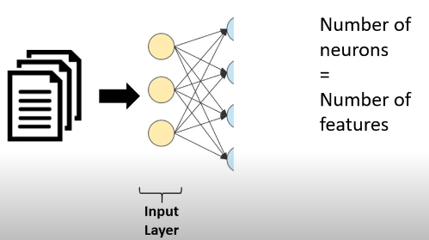
Neural Network

Slide 14
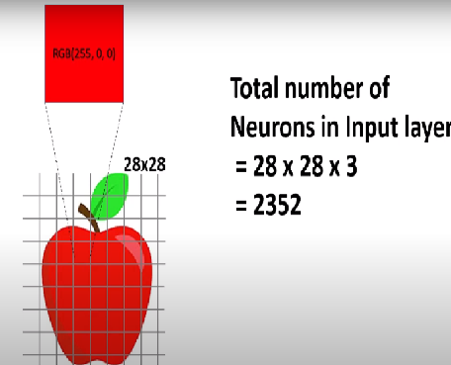
Neural Network
Each neuron holding color value of every pixel.

Slide 15
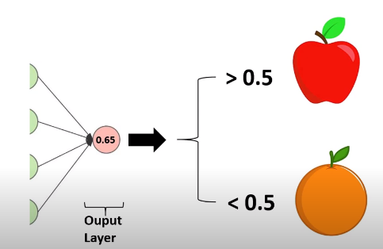
Neural Network
Output layer will have only one neuron having the value of probability. This value is responsible for identifying image as either an apple or orange

Slide 16
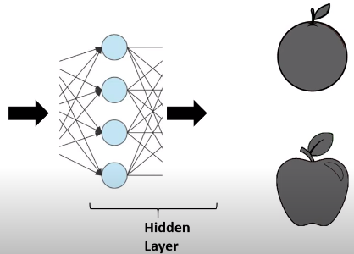
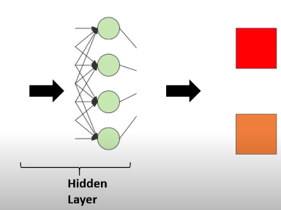
Neural Network
Hidden layers responsible for identifying different patterns. May be the first hidden layer is responsible for shape and second for color

Slide 17
Neural Network
We can use many neurons and layers if there are more patterns to capture.

Slide 18
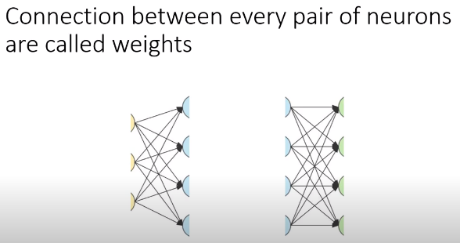
Neural Network

Slide 19
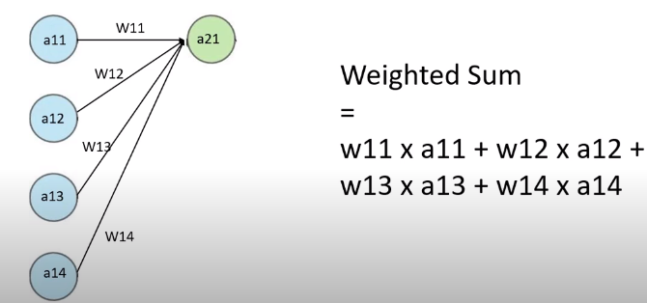
Neural Network

Slide 20
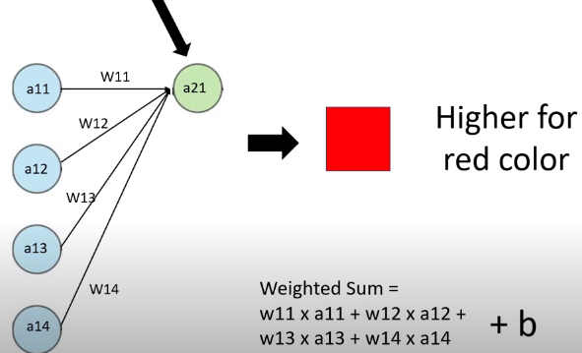
Neural Network
For example, this neuron might be responsible for recognizing color in central part of image so if its value is higher, it means there is red color which means it is apple
We can control weighted sum through bias. If bias is high, weighted sum is high otherwise low

Slide 21
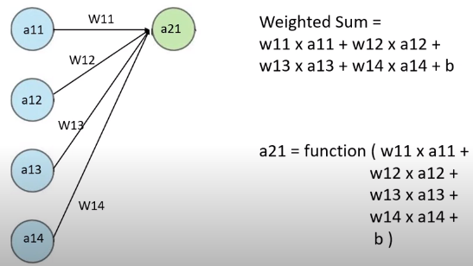
Neural Network
Then there are activation functions that decides whether a neuron should be activated or not. So this weighted sum is passed to that activation function. Some common activation functions are “relu”, “sigmoid”,”elu” etc..

Slide 22
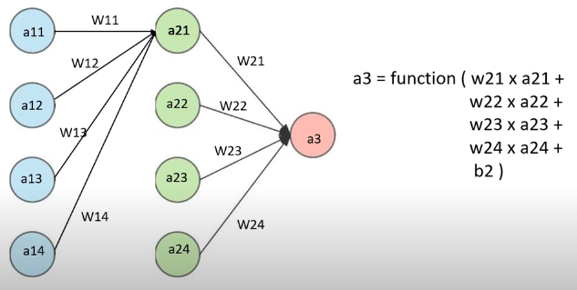
Neural Network
Then this goes on for calculating values in next layer till output is generated in final neuron (output layer). This process of calculating weighted sum then passing through activation function to generate final output is known as forward propagation. If a3 is the final output layer then value of a3 will be prediction of this neural network.

Slide 23
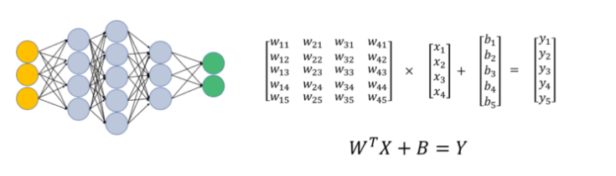
Neural Network
Another way to do forward propagation (for second hidden layer)

Slide 24
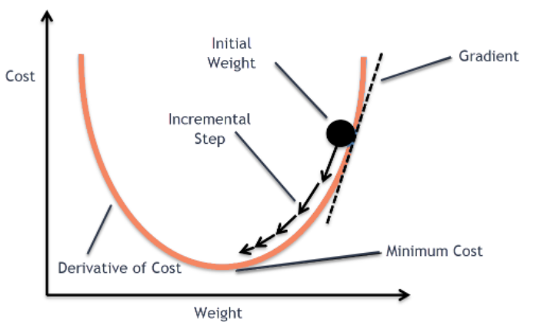
Neural Network
Gradient descent
Prediction is generated through forward propagation and then error is found from actual. To minimize the error, weights values are again adjusted through gradient descent algorithm in back propagation. Then forward propagation is again run on those updated weights. This keeps on going till we minimize error in our prediction.

Slide 25
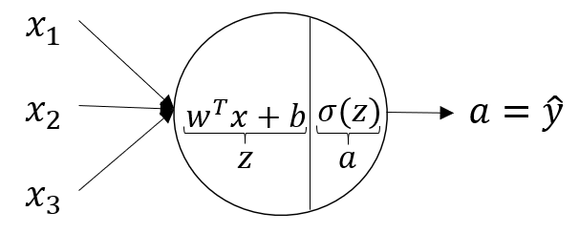
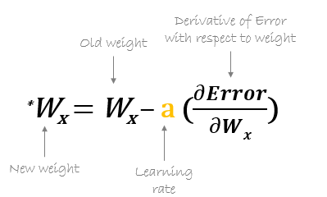
Neural Network
Formula for forward propagation
Formula for backward propagation

Slide 26
Neural Network
Lets see working of forward and backward propagation through example :

Slide 27
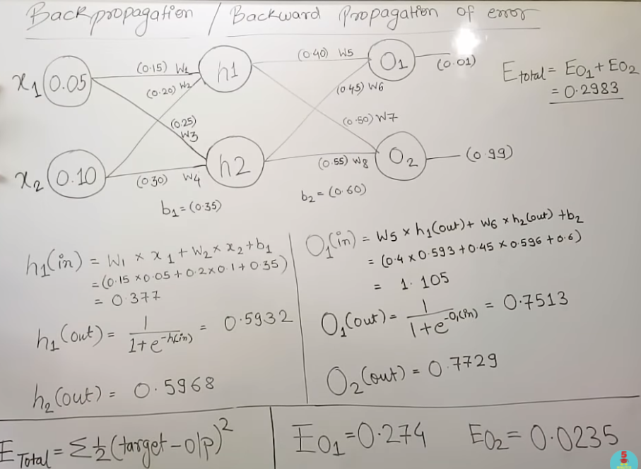
Neural Network

Slide 28
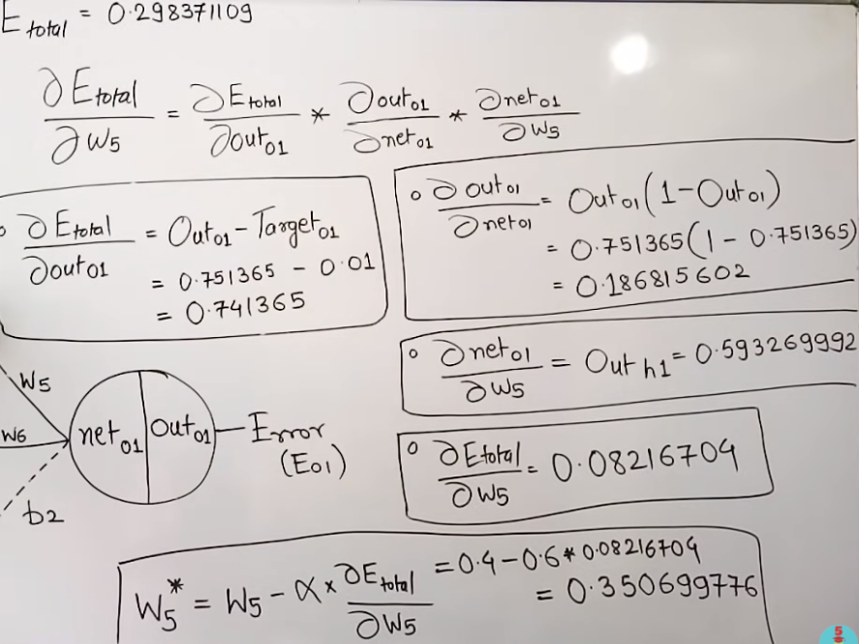
Neural Network

Slide 29
Neural Network
In this way, all weights are re-calculated and again forward propagation is applied on those weights to generate new prediction till we get minimum error

Slide 30
Neural Network
References :
Previous numerical is from 5 minutes engineering channel on youtube

